Slide 1

EPROJECT PRESENTATION
Care

Slide 2
Table of the content:
Introduction to Eproject
Supervisor and Co-Ordinator name
Group members Name and ID
Objectives
Problem Statement
Requirements
Flowchart Diagrams
DFD Diagrams
Main Images of Our Project
Conclusion

Slide 3
PROJECT SUPERVISOR AND CO-ORDINATOR
SUPERVISOR
CO-ORDINATOR
SIR Ebad-Uddin
MISS Munazzah

Slide 4
GROUP MEMBERS AND ID:
GROUP MEMBERS NAME
GROUP MEMBERS ID
Abdul Moiz Shahid
Student1417959
Ifra Asif
Student1424628
Hanzala Khan
Student1424612
Asad
Student1425119

Slide 5
OBJECTIVES:
Care PROJECT AND WEBSITE OBJECTIVES
To Provide Information:
The objective of this project, in simple terms, is to create a website that helps people find and book appointments with specialist doctors in their area. It also aims to maintain detailed records of both doctors and patients. This website makes accessing medical services easier and more convenient for everyone. In essence, the objective is to leverage technology to make the process of accessing medical services more user-friendly, efficient, and convenient. It's about providing individuals with a platform where they can quickly find the right healthcare options and book appointments with specialists, ultimately improving the overall healthcare experience.

Slide 6
Problem Statement:
We all need to visit doctors some time or the other. Sometimes it is an emergency situation, whereas most of the other time it is a planned checkup/visit. But in both the cases we have to visit the doctor to take an appointment or wait in long queues.
CARE Group is into medical services for long time and looking at the current medical scene have decided to come up with a WEBSITE, which will host the medical services available in different cities.
Individuals will be able to search for specialist doctors in their surroundings and even book online appointments.
Web site should also record the complete information regarding the Doctors and Patients.

Slide 7
REQUIREMENTS:
1) The Home Page should be created with sections, graphics and with a suitable
logo.
2) The site should display a menu with following categories:
• Home
• About
• Services
• Pages
•Contact
• Appointment

Slide 8
Flow chart {index.html}
HOME
About
Carousel, navbar, top layout
Service
Opening Hours and contact us
Pages
Contact
About Us section
Appointment
Make Appointment Section
Our Services Section
Our Pricing Plan Section
Appointment
Our Doctors Section
Footer

Slide 9
Flow chart {contact.html}
CONTACT
About
Carousel, navbar, top layout
Service
Contact banner section
Pages
Contact
Contact information section
Appointment
Map section
Footer

Slide 10
Flow chart {about.html}
About
About
Carousel, navbar, top layout
Service
About banner section
Pages
Contact
About Care section
Appointment
Appointment
Founder quote section
Footer

Slide 11
Some images of website:
HEADER
THIS IMAGE REPRESENTS OUR WEBSITE TOP LAYOUT.

Slide 12
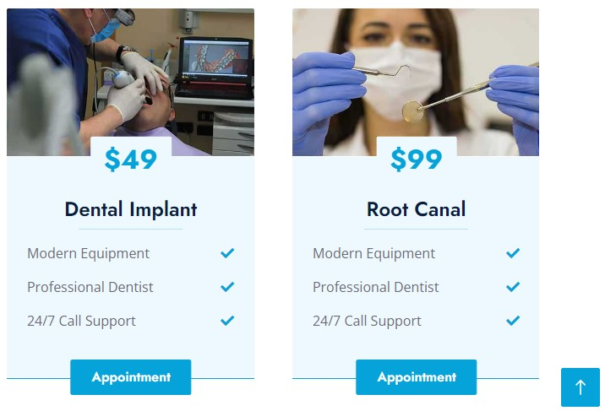
Some images of website:
Responsiveness
THIS IMAGE SHOWS RESPONSIVENESS OF OUR WEBSITE.

Slide 13
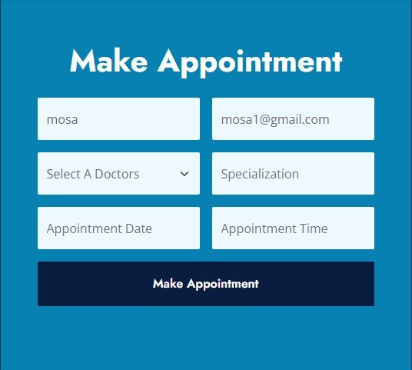
Some images of website:
Responsiveness
THIS IMAGE SHOWS RESPONSIVENESS OF OUR WEBSITE.

Slide 14
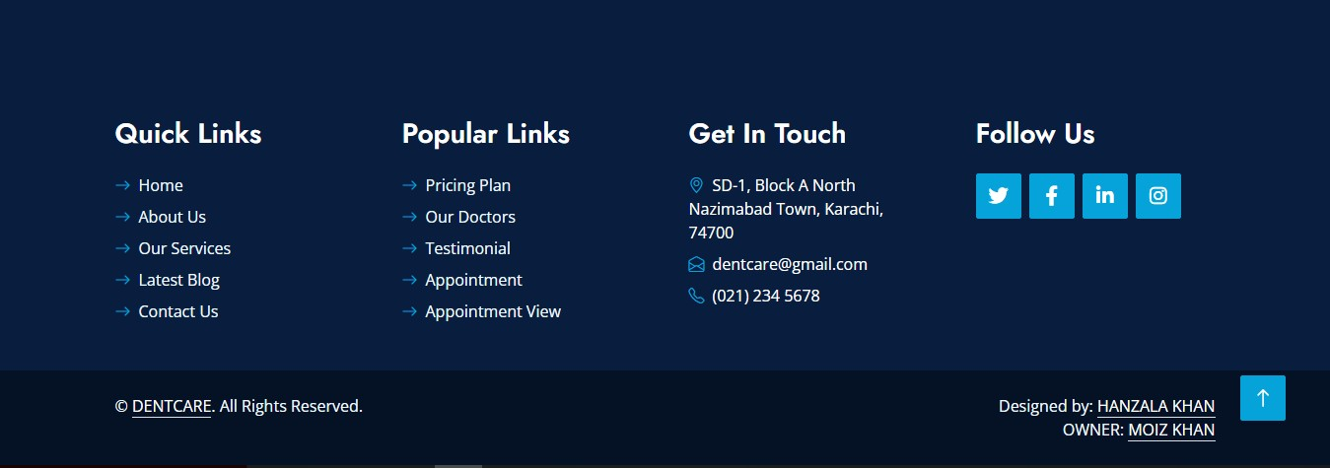
Some images of website:
Footer
THIS IMAGE REPRESENTS OUR WEBSITE END LAYOUT.

Slide 15
Conclusion
This project is done by our team on time. Thanks to all who help us in this assignment especially our honourable faculty, he did very great job and treat us like our elder brother, without him we cant able to do a 10% of it. Thanks to you sir!
Thanks to eproject team who give us a project which we can use as help for taking good skills in programming, documentation and presentation. We learn a lot from this great project and hope incoming semester we also keep our progress like it is.

Slide 16
Thanks to you all!
Good luck!

